Slide 1
The bet-ter choice: exploring putative dopamine effects on cost-benefit decision making
4.23.2019
Guillaume Pagnier

Slide 2
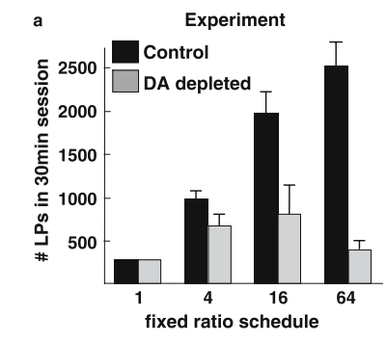
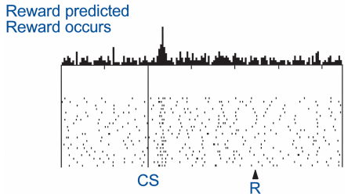
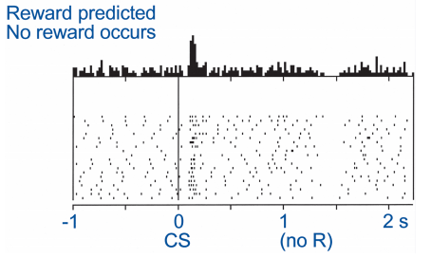
What does dopamine (DA) do?
Lots of things
Future behavior (learning)
Current behavior (performance)
Fast, phasic DA spikes in the striatum occur when participants experience reward prediction errors and modulate learning.
DA lesions leads to akinetic movements and the choice to not pursue rewards

Slide 3
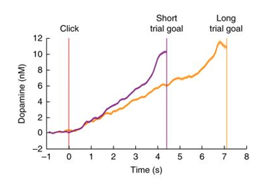
Striatal DA ramps as animals approach a reward

Slide 4

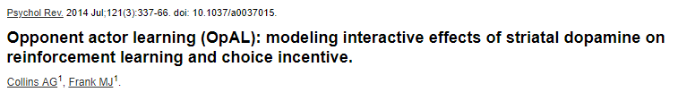
So what does DA do?
Indiscriminately increasing vigor of any action
Modulates perceived rewards and/or perceived costs

Slide 5
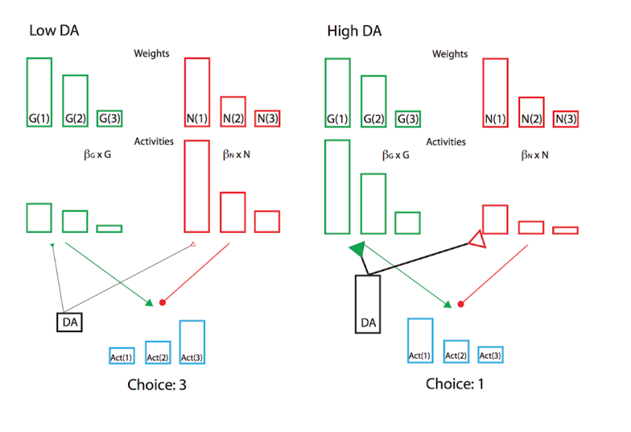
Do fluctuating levels of DA bias value perception?
At different levels of DA, participants may be perceiving value differently.
High DA -> high emphasis on rewards
i.e. participants should prefer risky gambles and respond
faster as the potential reward is higher

Slide 6
Do humans’ propensity to gamble / speed vary as striatal DA changes (via proximity to reward)?

Slide 7
How to elicit DA ramp?
Gamble?
Gamble?
Gamble?

Slide 8
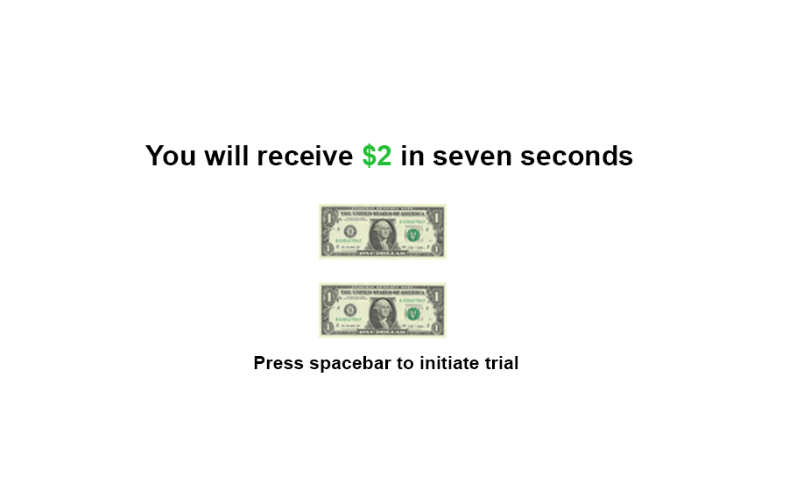

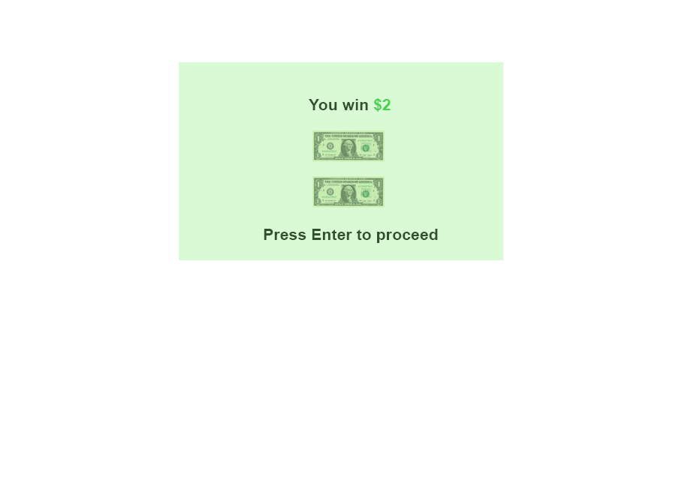

Slide 9
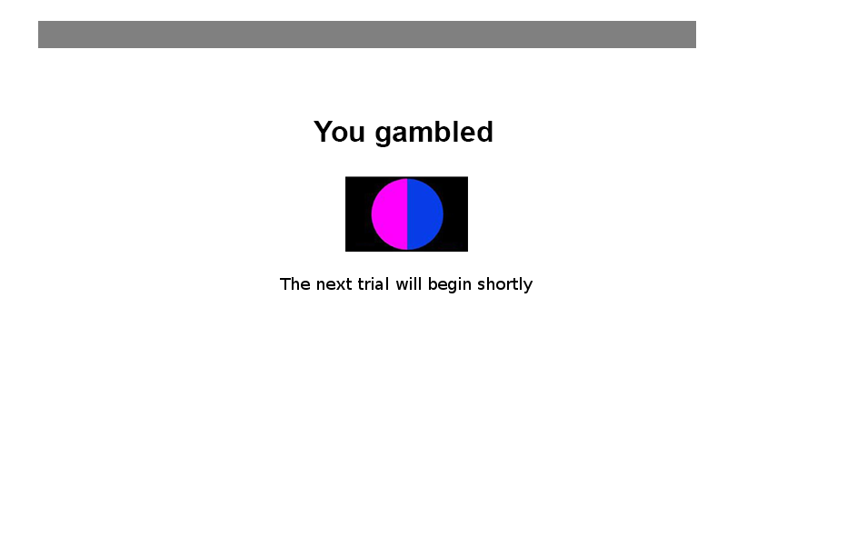
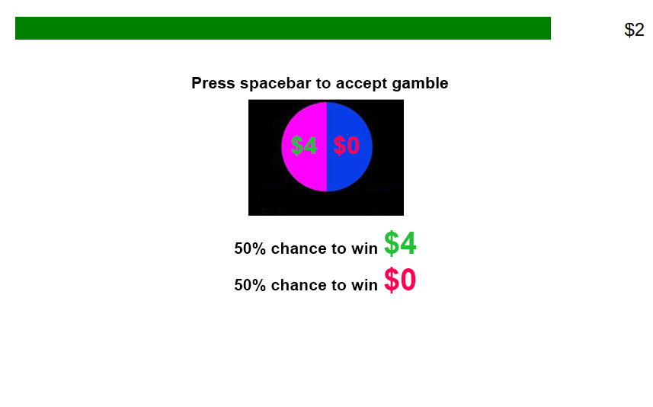

Slide 10
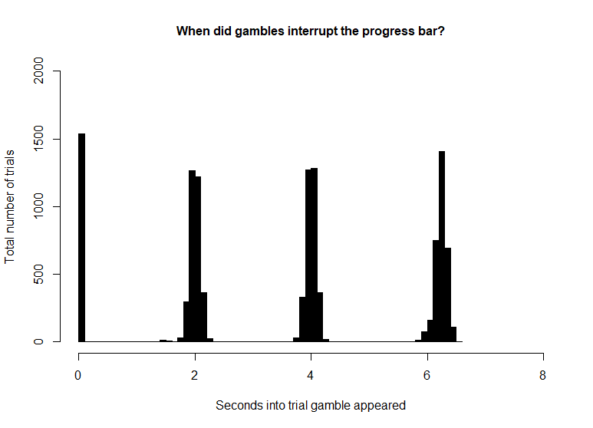
207 Participants via Amazon’s mechanical turk; (127 male; 76 female; 4 declined to answer)
140 participants analyzed
18-40 years old
133 trials (~45 minutes)
Option to gamble on 86.39 % of trials.
Gamble probablilities were always 50%
Gamble losses were always 0$
Magnitude
Low
Trials that offer $1 or $2
Mid
Trials that offer $3 or $4
High
Trials that offer $5 or $6
Value
Low
Gambles that offer 1.5* guaranteed amount
Mid
Gambles that offer 2* guaranteed amount
High
Gambles that offer 3* guaranteed amount

Slide 11
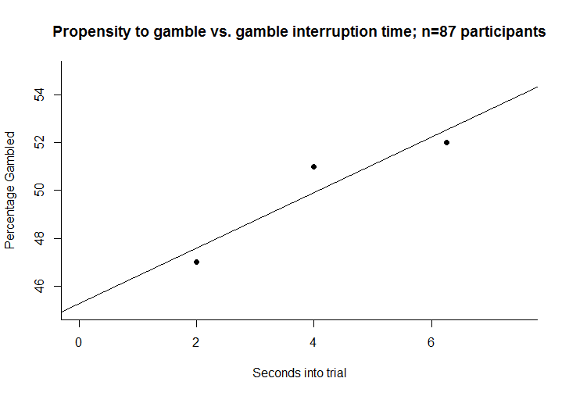
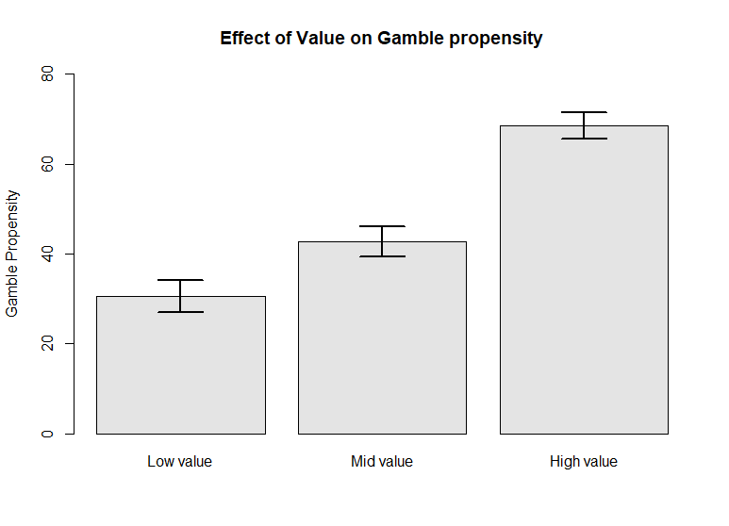
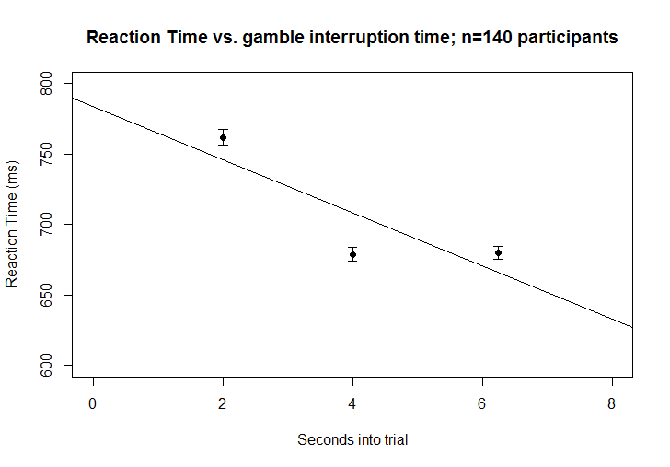
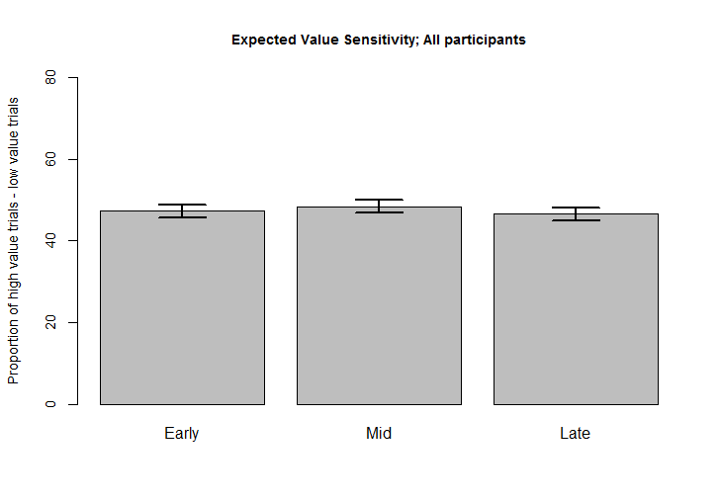
Gamble propensity vs. gamble interruption time
EV on gamble propensity
Reaction Time vs. gamble interruption time
EV sensitivity; all participants

Slide 12
Version coefficients

